Slide 1
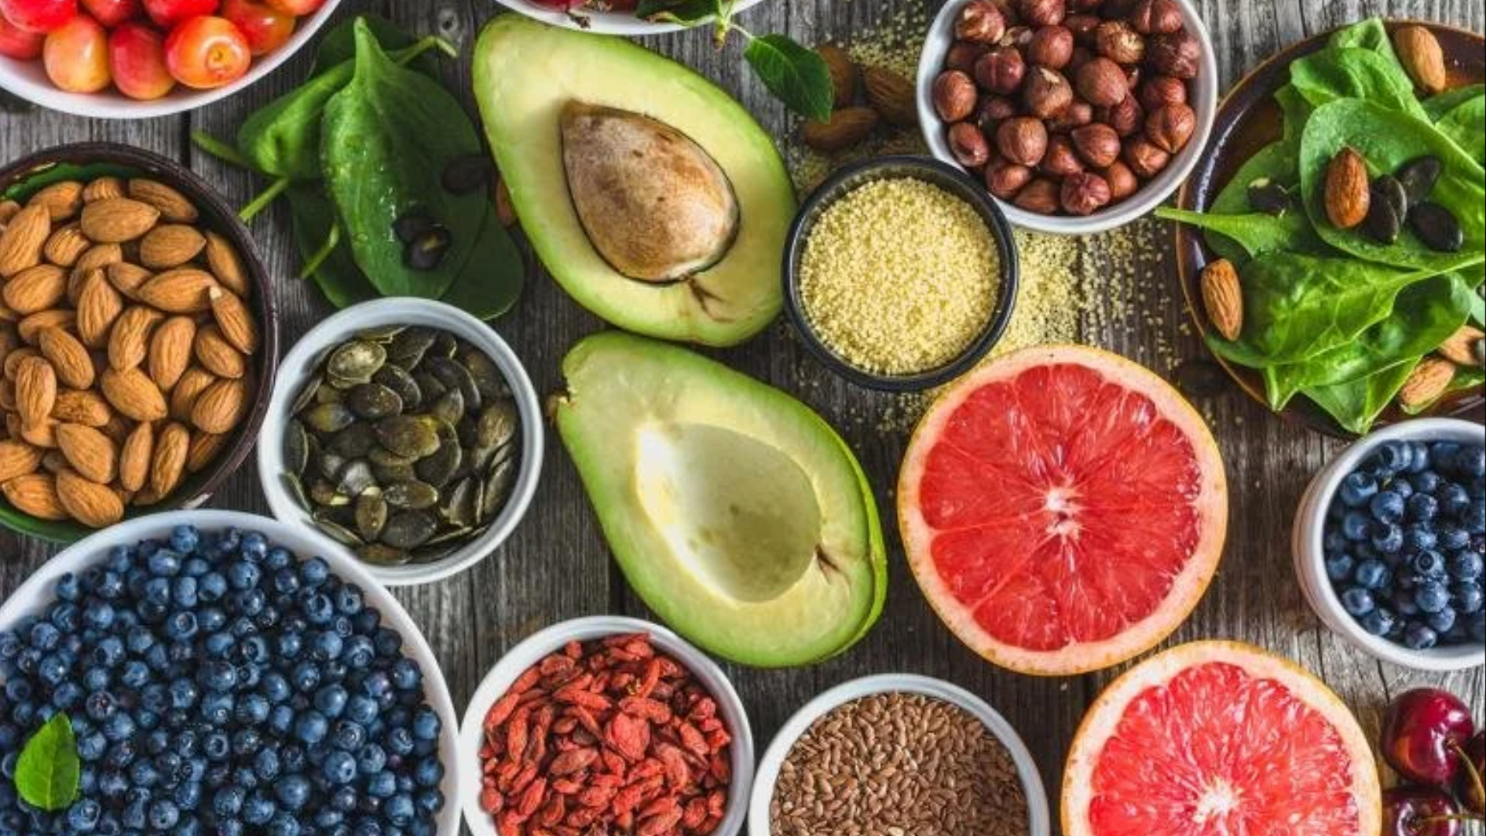
Food Recipes Relational Analysis and Recommendation System
Koh Zhi Rong Chester
Low Jia Sheng Nelson, Ong Kian Eng
Zhao Zhen, Zhou Jingyu

Slide 2
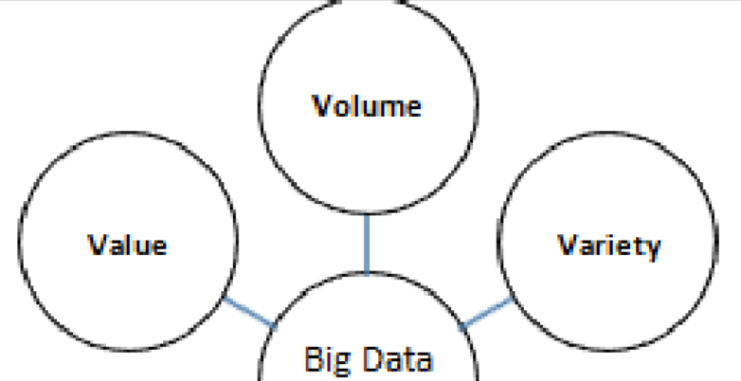
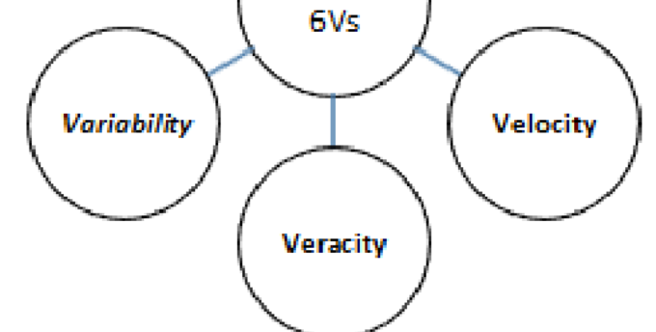
Problems
Business
Technical
Business Case
Large volume and variety of recipes from various websites → Difficult to quickly find suitable menu (based on taste and cooking style).
Consolidate online recipes to recommend suitable recipes for users
Integrate data from IoT sensors (e.g. currently available ingredients in fridge)
Provide more accurate and personalized recipe recommendation leveraging on graphs
Target Audience
Ideal for people who wish to cook, especially for those searching for recipes that cater their preference.
Volume: More than 250,000 recipes
Velocity: Batch Processing
Varity: Unstructured data & graph data
Value: Recommendation
Variability: changing data once a week
Veracity: Availability
Notes:
With the proliferation of online recipe sites, it is increasingly difficult for people who want to cook to choose recipes among an ocean of recipe websites and quickly find a menu that suits both their taste and cooking style. To solve this problem while seize the opportunity, we initialized a Web?, which not only aggregate online recipes from multiple sources, but also recommend recipes to users based on their preferences. {In the next phrase, we will incorporate data from sensors, which provides information about the ingredients in the fridge (type and the amount of ingredients), to provide users with more accurate and personalized recipe recommendation service.}

Slide 3
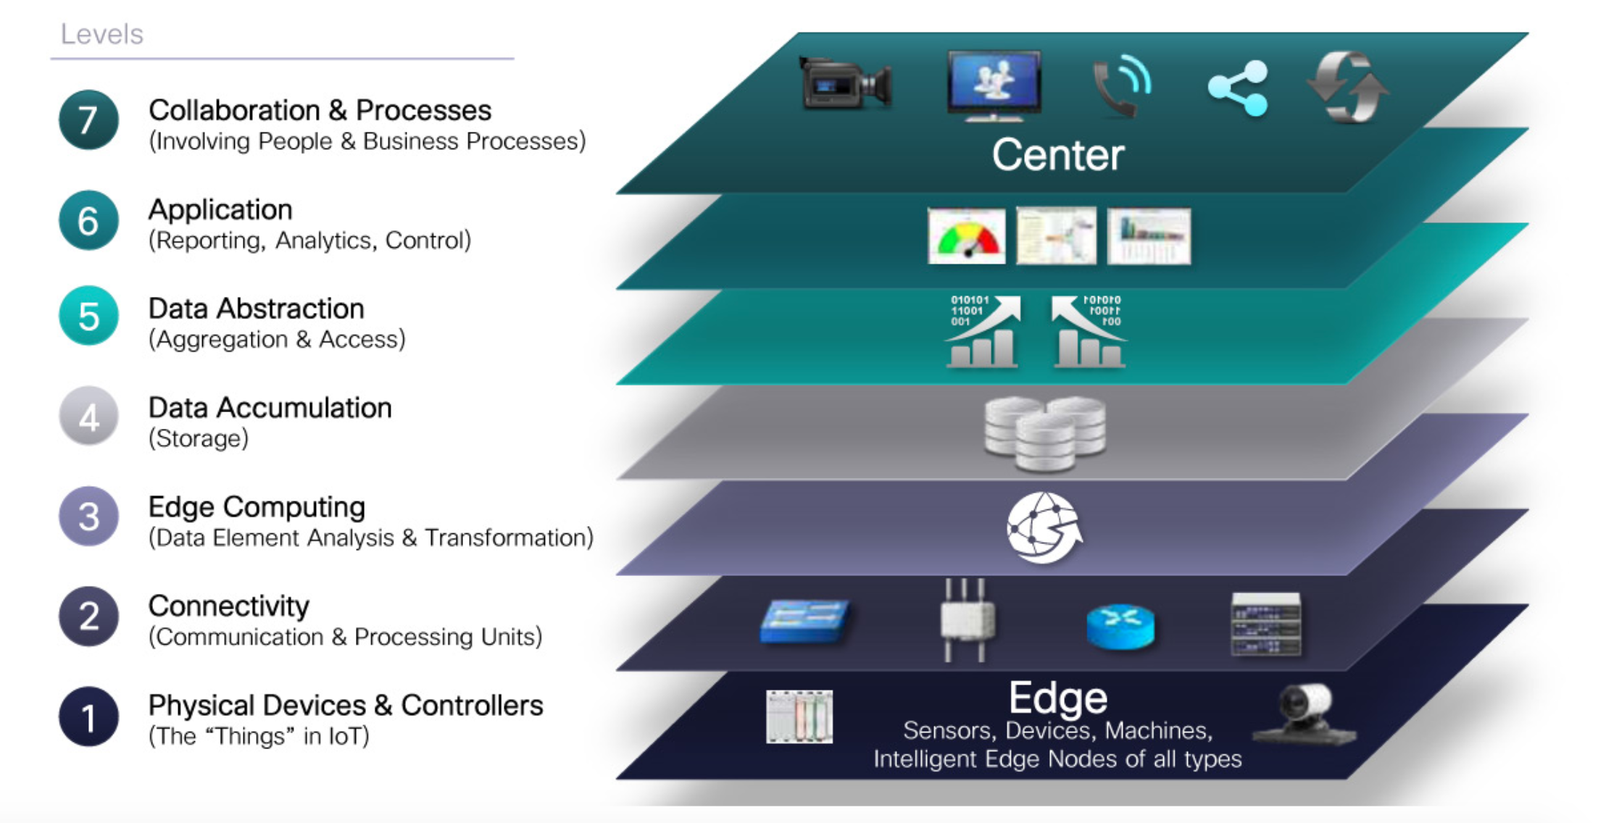
IOT
Recipe Websites
Recipe Dashboard
Features Engineering
Data in HDFS
Server / Fridge
Wifi Connection
Smart Fridge

Slide 4
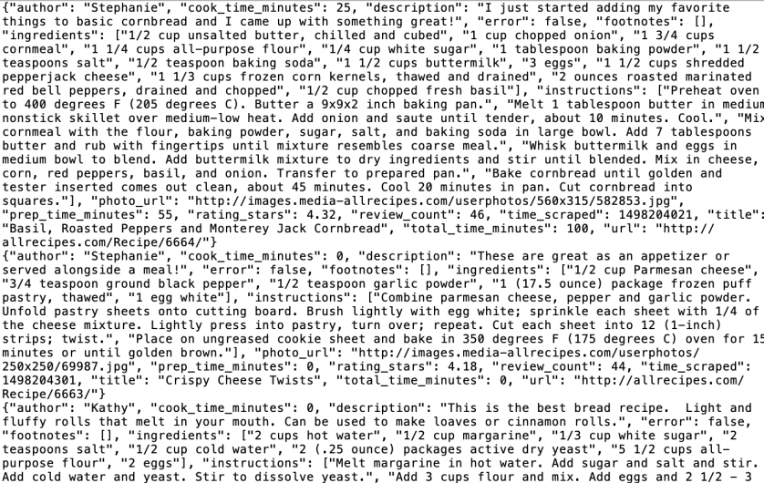
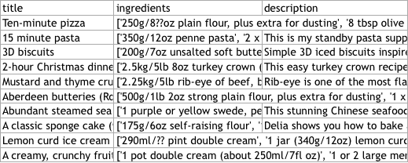
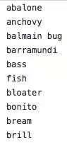
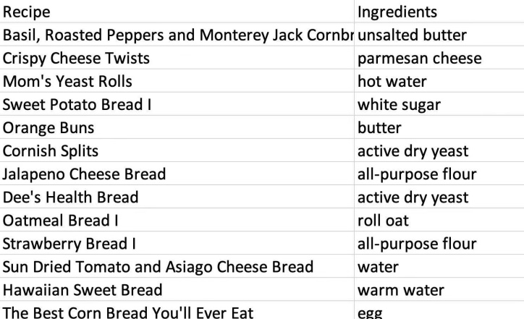
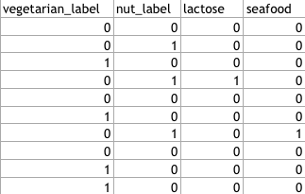
Dataset Transformation
Text cleaning
Text Feature Engineering
Derive recipe tags (eg. seafood/ vegetarian)
Original Data
Cleaned Data

Slide 5
Analytics in Graph
Detect community to recommend similar category of recipe based on shared ingredients
Use cases：
Recommend new dishes that uses same ingredients (Explore)
Recommend similar dishes (Enhanced search because keyword search will only return exact keywords but not similar dishes)
Assumption: More shared ingredients there are, More similar recipes are

Slide 6
Big Data
Architecture
Data Source & Ingestion
Storage
Processing
Visualization
Drill
(retrieve all clean JSON files ; append new records to create database)
API/ IOT data
HDFS
1. Store raw file for archival
2. Cleaned data (JSON) for long term storage
(large data storage)
Python & PySpark
Python to web scrape, run Shell commands
PySpark to clean large volumes of text
query Drill
Shiny in R
( Interactive Dashboard
For Users )
R
display in Shiny
query Neo4j
Drill
Drill database (in parquet)
Store as JSON file
Neo4j

Slide 7
How the dashboard work?
User Action
Drill Query
Process
Once the user select the ingredients and/or recipes type;
R will call drill to filter the recipe;
Meanwhile R will also call neo4j to give the recipe ;recommendation by graph
The users can get the recipes list of what they want to cook
Select Ingredients and/or Recipes in R Shiny
R to query Drill
Query ingredients for recipe
Recipes Recommendation by Graph
R to query Neo4j
Build Recipe recommendation
Recipes List
R to call Shiny
Shiny to connect drill

